Slide 1
# Mattress discarded SEA

Slide 2

Connecting Supply Chains
Chemical Industry
PU Industry
Mattress
Industry
Consumers
Recycling Industry

Slide 3
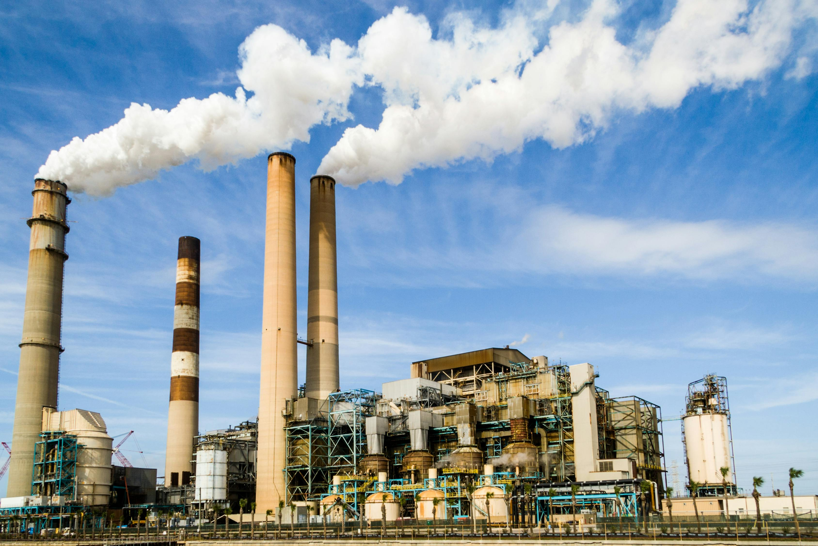
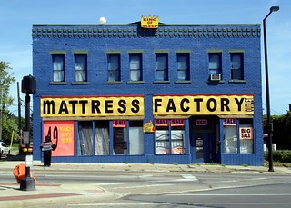

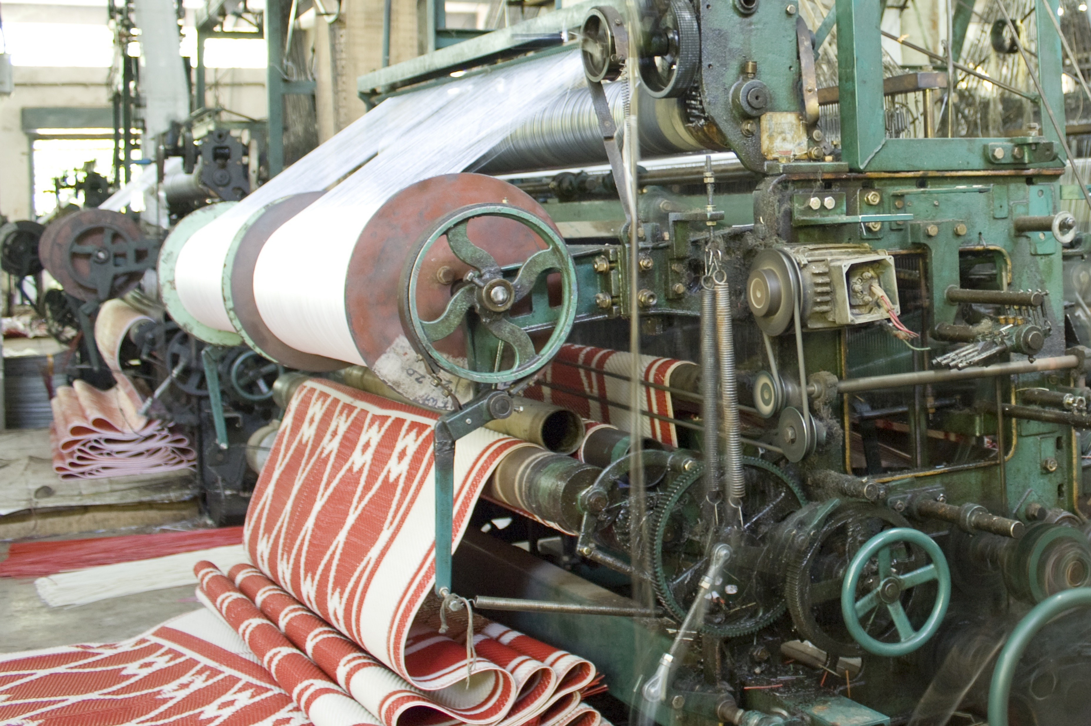
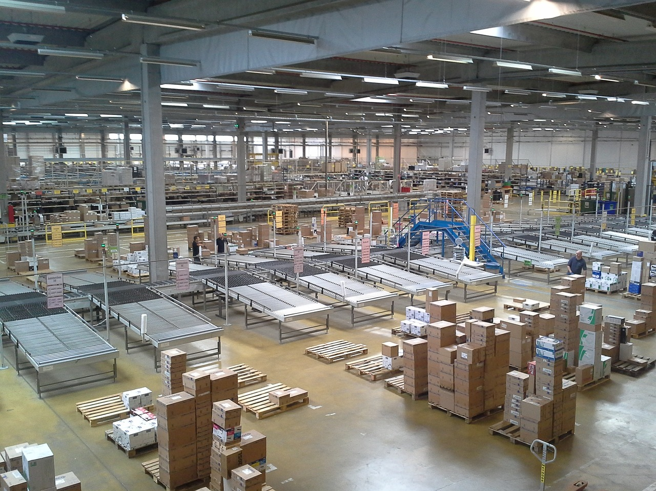
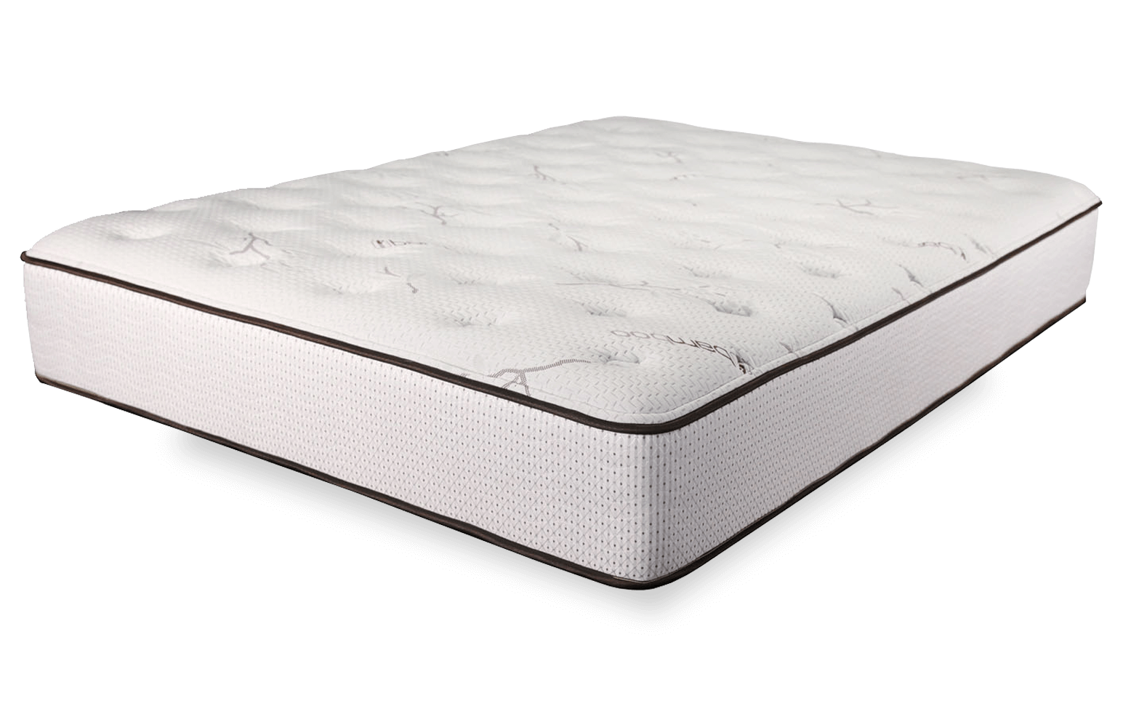
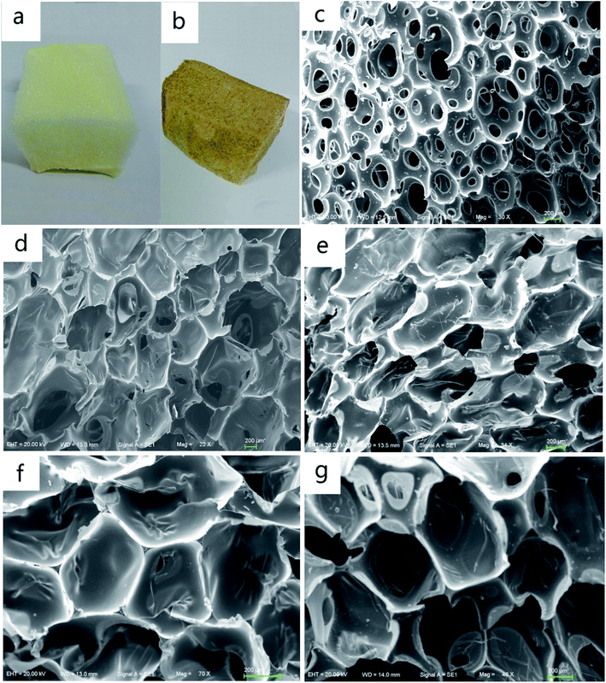
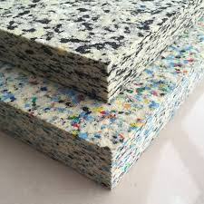
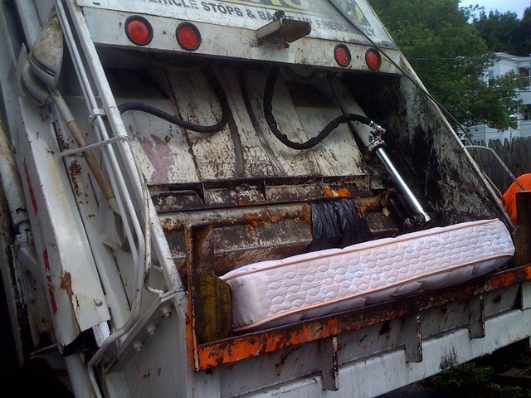
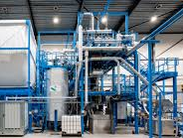
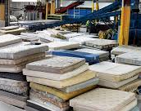
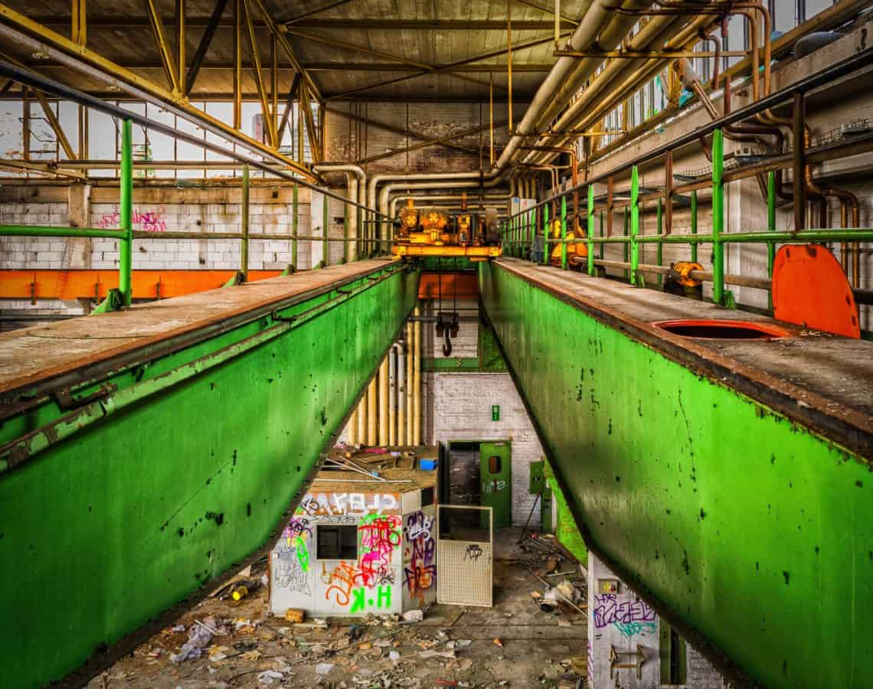
Lifespan of mattress 8-10 year (global average)
Steel (wire)
Consumers
Wire
(Springs)
Textile
Textile
PU foam
PU Foam
Collection
Trimfoam
Rebonded
Foam
Repolyol
Shredded Steel
Mattress Dis-assembly & Component Processing

